Slide 1
WELCOME
Class: B.Com – Part-1
Subject: Financial Accounting
Topic – Non Trading Organization: c. Balance sheet
Prepared By
Dr. SHAHID IQBAL
Guest Faculty
Marwari College, Darbhanga,
Mobile no. and whatsup no. : 7004160257
Email ID: shahidlnmu@gmail.Com

Slide 2
Balance Sheet:
There are several components of the accounting system of non-profit organization. This includes the balance sheet as well. Preparation of balance in the case of non-trading or non-profit making concern and preparation of balance sheet in the case of a trading firm is same. It has all liabilities and assets as on the date of the preparation of the balance sheet by the organization. The excess of assets over the liabilities is termed as Capital Fund or the General Fund.
However, Balance Sheet is a summary of whole of the accounting record. This is because the nominal accounts are transferred to Revenue Accounts, and Revenue account is closed by shifting the balance to the Balance Sheet. Balance Sheet is also known as a statement of Assets and Liabilities.

Slide 3
Features Of Balance Sheet:
Balance sheet has the following features:
It is the last stage of final accounts
It is prepared on the last day of an accounting year.
It is not an account under the double entry system - it is a statement only.
It has two sides - left hand side known as asset side and right hand side known as liabilities side.
The total of both sides are always equal.
The balances of all asset accounts and liability accounts are shown in it. No expense accounts and revenue accounts are shown here.
It discloses the financial position and solvency of the business.
It is prepared after the preparation of trading and profit and loss account because the net profit or net loss of a concern is included in it through capital account

Slide 4
Importance Of Balance Sheet:
Balance sheet analysis can reveal a lot of important information about a company’s performance. Importance of balance sheet is listed below:
It is an important tool used by the investors, creditors and other stakeholders to understand the financial health of an entity.
The growth of an organization can be known by comparing the balance sheet of different years.
It is an essential document required to be submitted to the bank to obtain a business loan.
Stakeholders can understand the business performance and liquidity position of the entity.
Ability to undertake expansion projects and meet unforeseen expenses can be determined by analyzing a company’s balance sheet
If the company is funding its operations with profit or debt can be known

Slide 5
Limitations Of Balance Sheet:
1. It is prepared on a historical cost basis. Changes in prices are not considered.
2. Window-dressing may be done in Balance Sheet.
3. Historical Cost of Balance Sheet does not convey fruitful information.
4. Different assets are valued according to different rules.
5. It cannot reflect the ability or skill of staff.
6. It is measured in terms of money or money’s worth. That is, only those assets are recorded in it which can be expressed in money.
7. In inflationary trend, if the readers are not expert may mislead.
8. Balance Sheet has some fictitious assets, which have no market value. Such items are unnec­essarily inflate the total value of assets.

Slide 6
Preparation of Balance Sheet for Non-Profit Organization:
The balance sheet of a non-profit organization is prepared in the same manner as in the case of a business enterprise. The assets of the organization are recorded on the Right side and liabilities on the Left side. The Non-profit organizations do not use the term Capital. Instead, General Fund or Accumulated Fund appears on the Balance Sheet.
The NPO might also create a special fund, such as prize fund or match fund. The purpose of which is to meet the expenses related to the purpose for which it is created. The incomes on the amount which is invested from these funds accrue to the fund alone and not the income and expenditure account.

Slide 7
Accounting Treatment Of General Fund And Preparation Of Balance Sheet:
Preparation of a balance sheet starts with the general fund. You have to add the respective surplus or deficit in the amount.
Further, add life membership fees or legacies at this stage.
Put all fixed assets on the asset side of the balance sheet.
Showcase the amounts paid in advance and amount due on the assets and liabilities side.
Post the closing balances of the assets and liabilities on the respective side of the balance sheet.
To calculate the amount of the fund, deduct the value of total liabilities from the value of assets.

Slide 8
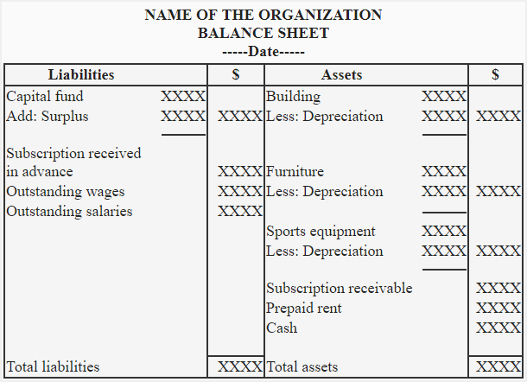
Specimen Of Balance Sheet

Slide 9
THANKS

